Slide 1

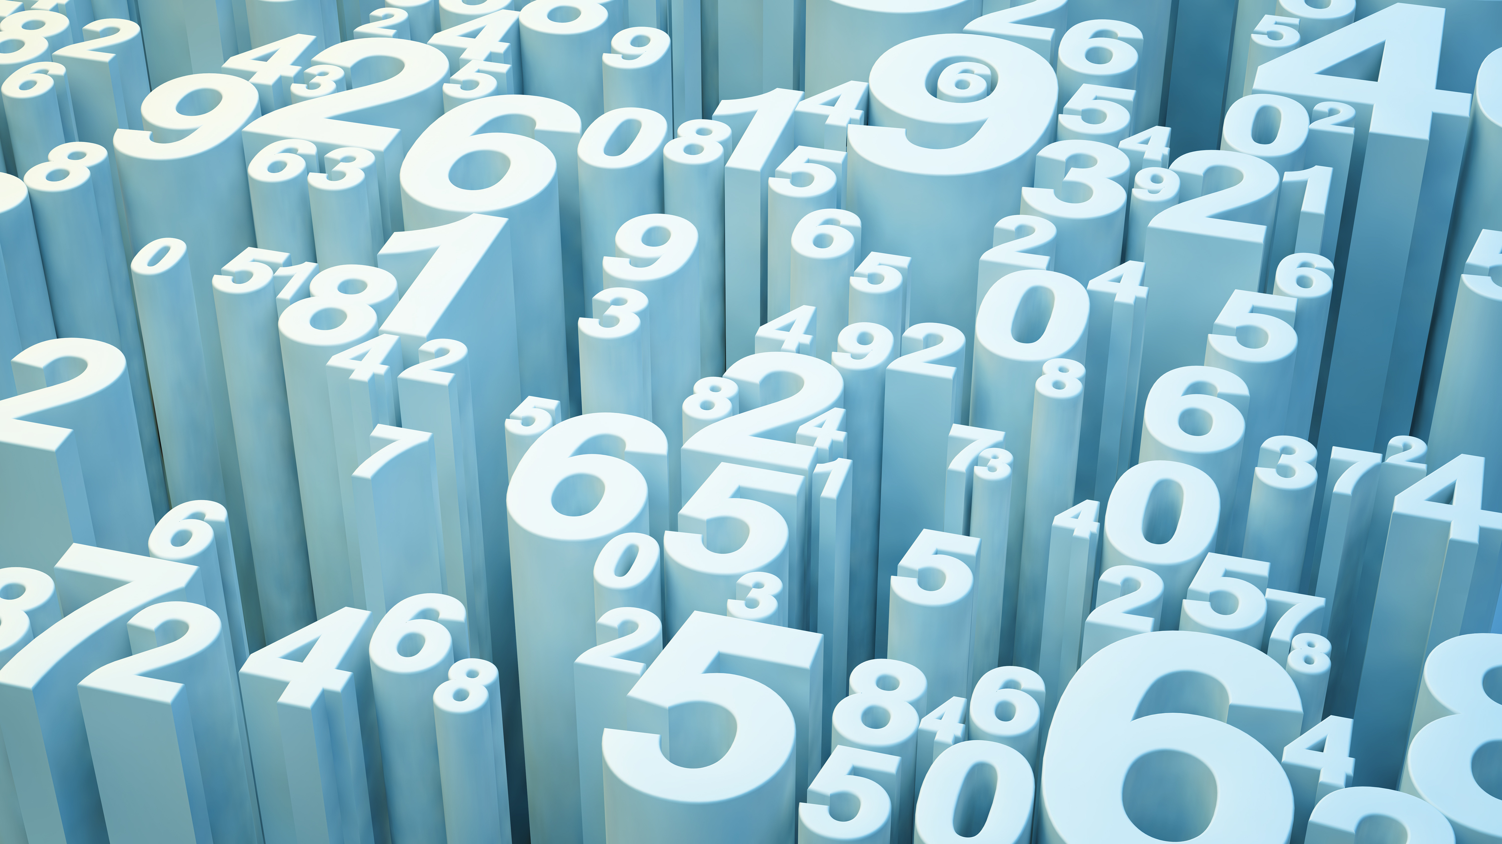
Variability
Santosh Chhatkuli

Slide 2
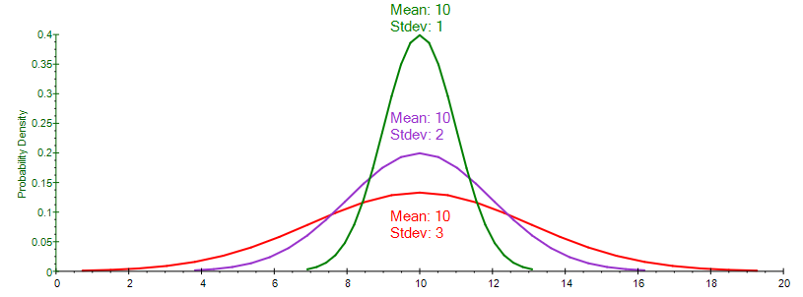
What is variation?
The degree to which numerical data tend to spread about an average value is called variation. It is the second important property that describes a set of numerical data.
The study of average alone is inadequate to give us a complete idea about distribution. Two or more distributions can be following:
Same in terms of central value and spread
Same in terms of central value but different in terms of variation
Different in terms of central vale but same in terms of variation
Different in terms of central vale and variation
Graph

Slide 3
Consider three hypothetical data sets.
Data set I: 7 8 9 10 11
Data set II: 3 6 9 12 15
Data set III: 1 5 9 13 17
The three distribution are all same in terms of average since they have identical mean i.e. 9 but are different in terms of variation. Data set 3 is most variable since it has high range (16) of values and data set 1 is most consistent because it has small range (4) of values.
When assessing the variability of a data set, there are two key components:
How spread out are the data values near the center?
How spread out are the tails?

Slide 4
Measures of variation or spread may be either absolute of relative.
Absolute measures of variation
Absolute measures of variation refer to an absolute magnitude of the average of deviations in individual values and are expressed in the same units in which the variable are measured.
Range
Inter-fractile range/Inter-percentile range
Mean Deviation
Standard Deviation
Variance
Relative measures of variation
A measure of relative variation is the ratio of a measure of absolute variation to an appropriate average. In comparing the variability of two or more distributions, relative measures are useful.
Coefficient of range
Coefficient of inter-fractile range
Coefficient of Mean Deviation
Coefficient of variation

Slide 5
Range
Range is the difference between the highest and lowest observed value.
Range (R) = x_{max} – x_{min}
Coefficient of range =
Example:
The scores of individual students in the examination and coursework component of a module.
Range of score for coursework is 48 – 23 = 25 and that for examination is 47 – 12 = 35. This indicates that there was greater variation in the students’ performance in the examination than in the coursework for this module.
Coefficient of range for coursework = 48 – 23 / 48 + 23 = 0.3521 = 35.21 %
Coefficient of range for Examination = 47 – 12 / 47 + 12 = 0.5932 = 59.32 %
Student | A | B | C | D | E | F | G | H | I | J | K | L | M | N
Coursework | 27 | 44 | 39 | 23 | 41 | 48 | 37 | 34 | 40 | 43 | 30 | 43 | 29 | 27
Examination | 12 | 47 | 26 | 25 | 38 | 45 | 35 | 35 | 41 | 39 | 32 | 25 | 18 | 30

Slide 6
Properties
It is simple but crude measure of variation
It is used to get idea of spread of whole distribution
It gives a quick sense of its spread
It is based upon two observations only (highest and lowest). So it is not reliable measure.
It is heavily influence by extreme values.
It ignores the nature of variation among all the other observations. The spread near the center of the data is not captured at all.
Uses:
Analysis of stock data; the difference between highest and lowest value of stock.
Analysis of temperature difference per day.

Slide 7
Fractiles or Partitioning values
A fractile is the cut off point for a certain fraction of a sample.
Fractiles are:
Quartiles
Deciles
Percentiles
Quartiles:
Quartiles are partitioning values which divide the data in four equal parts and in three points. The three partitioning points are:
Q₁ = First Quartile or Lower Quartile.
Q₂ = Second Quartile and equals to median.
Q₃ = Third Quartile or Upper Quartile.
Deciles:
Deciles are partitioning values which divide the whole distribution in ten equal parts and in nine points. There are nine partitioning points and are symbolized by D₁, D₂... D₉
Percentiles are those partitioning values which divide the data set into hundred equal parts and in ninety nine points. Obviously there are ninety nine partitioning points are symbolized by P₁, P₂,..., P₉₉.

Slide 8

Inter-fractile Range
Inter-Quartile range or Middle 50 % rang or Quartile Deviation = Q₃ – Q₁
It considers the spread in the middle 50 % of the data and therefore it is not influenced by extreme values. A large IQR indicates a large amount of variability among the middle 50 % of the observations and small IQR indicates that the main bulk of the data is fairly concentrated
25% 25% 25% 25%
Xmin Q1 Q2 Q3 Xmax
_{Semi-interquartile range =}
Coefficient of Quartile Deviation =
2. The inter-fractile range between 5th and 95th percentile = Middle 90 % range = P₉₅ – P₅
It considers middle 90 % variability.
3. Middle 80 % range = P₉₀ – P₁₀ = D₉ – D₁
4. Middle 60 % range = P₈₀ – P₂₀ = D₈ – D₂
5. Middle 40 % range = P₇₀ – P₃₀ = D₇ – D₂
$$\frac{Q_{3}−Q_{1}}{2}$$

Slide 9






Computing fractiles
Individual data/Raw data/Ungrouped data
Example: The following data represent the length of life in years, measured to the nearest tenth, of 30 similar fuel pumps:
2.0 3.0 0.3 3.3 1.3 0.4
0.2 6.0 5.5 6.5 0.2 2.3
1.5 4.0 5.9 1.8 4.7 0.7
4.5 0.3 1.5 0.5 2.5 5.0
1.0 6.0 5.6 6.0 1.2 0.2
Find first, second and third quartile
Find interquartile range (middle 50 % range)
Find P₈₀ and D₄
Construct Box-and-whisker plot and comment on the shape of distribution
Solution:
Here the variable (X) = Life of fuel pumps (in years)
Sample size (n) = 30
Data Array
0.2 0.2 0.2 0.3 0.3 0.4
0.5 0.7 1.0 1.2 1.3 1.5
1.5 1.8 2.0 2.3 2.5 3.0
3.3 4.0 4.5 4.7 5.0 5.5
5.6 5.9 6.0 6.0 6.0 6.5
Q₁ = The value of ordered data
= The value of 7.75th ordered data
= The value of 8th ordered data
= 0.7
Q₂ = The value of ordered data
= The value of 15.5th ordered data
= Average value of 15th and 16th ranked data
= = 2.15
Q₃ = The value of ordered data
= The value of 23.25th ordered data
= The value of 23rd ordered data
= 5.0
IQR = Middle 50 % range = Q₃ –Q₁ = 5.0 – 0.7 = 4.3 years
P₈₀ = The value of ordered data
= The value of 24.8th ordered data
= The value of 25th ordered data
= 5.6
D₄ = The value of ordered data
= The value of 12.4th ordered data
= The value of 12th ordered data
= 1.5
$$\frac{2(n+1)^{th}}{4}$$
$$\frac{2.0+2.3}{2}$$
$$\frac{3(n+1)^{th}}{4}$$
$$\frac{80(n+1)^{th}}{100}$$
$$\frac{4(n+1)^{th}}{10}$$
$$\frac{1(n+1)^{th}}{4}$$

Slide 10
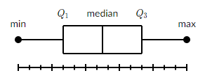
Box-and-whisker plot
A box and whisker plot also called a box plot, displays the five-number summary of a set of data. This tool is used to detect symmetry or non-symmetry of a data set. It also tells variability in the middle 50 % of the data and in the tails (right or left)
The five number summary is:
X_{min} = Lowest observation in the data set
Q₁ = First Quartile
Q₂ = Second Quartile
Q₃ = Third Quartile
X_{max} = Highest observation in the data set
In a box plot, we draw a box from the first quartile to the third quartile. A vertical line goes through the box at the median. The whiskers go from each quartile to the minimum or maximum.

Slide 11
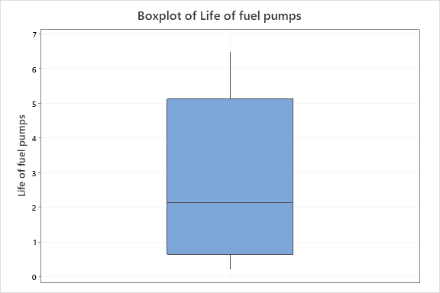
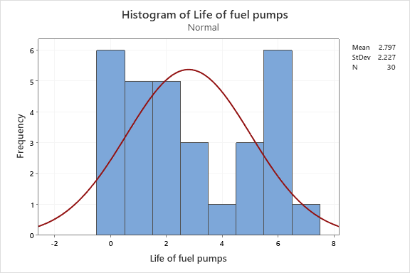

Slide 12
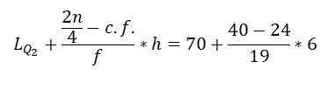



Computing partitioning values in frequency distribution
Solution:
Here the variable of interest (X) = Grades of students in Statistics
Size of the sample (n) = 80
Computing Quartiles
First Quartile (Q1)
Q₁ = Size of ordered data = 20th ordered data
Hence, Q₁ falls in the class 64 – 70.
The actual Q₁ is given by,
Q₁ = = 67.6
Second Quartile (Q2)
Q₂ = Value of ordered data = 40th ordered data
Hence, Q₂ falls in the class 70 -76
Then actual Q₂ is given by,
Q₂ = = 75.05
Example:
The grades of students in Statistics module is given in following frequency distribution
Compute Q1, Q2 and Q3
Compute middle 50 % range
Compute middle 80 % range
Draw a box-and-whisker plot and comment on the nature of the distribution
$${\left(\frac{n}{4}\right)}^{th}$$
$$L_{Q_{1}}+\frac{\frac{n}{4}−c.f.}{f}∗h=64+\frac{20−14}{10}∗6$$
$$2{\left(\frac{n}{4}\right)}^{th}$$
$$L_{Q_{2}}+\frac{\frac{2n}{4}−c.f.}{f}∗h=70+\frac{40−24}{19}∗6$$

Slide 13
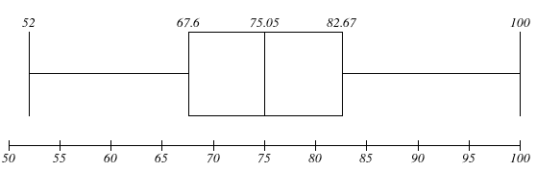

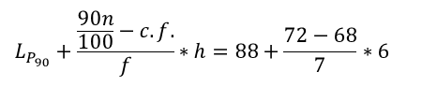


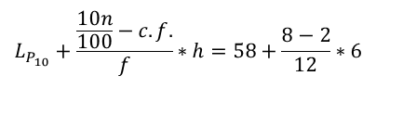

Third Quartile Q₃
Q₃ = Value of ordered data = 60th ordered data
Hence, the third quartile lies in the class 82 – 88
The actual Q₃ is given by the formula
Q₃ = = 82.67
The inter-quartile range (middle 50 % range)
= Q3 – Q1 = 82.67 – 67.6 = 15.07
The range of variability of marks of middle 50 % is mere 15.07
Tenth Percentile P₁₀
P₁₀ = Value of ordered data = 8th ordered data
Hence, tenth percentile P10 lies in the class 58 – 64
The actual P₁₀ class is given by
P₁₀ = = 61
Ninetieth Percentile P₉₀
P90 = Value of ordered data = 72nd ordered data
Hence, the actual P90 class falls in the class 88 – 94
Now, the actual P90 is calculated as follows
P₉₀ = = 91.43
The middle 80 % range = P₉₀ – P₁₀ = 91.43 – 61 = 30.43
Hence, the variability of marks for the middle 80 % (64 ) students is 30.43.
Box-and-Whisker plot
The five number summary is given by
X_{min} = 52 Q₁ = 67.6 Q₂ = M_{d} = 75.05 Q₃ = 82.67 X_{max} = 100
$$3{\left(\frac{n}{4}\right)}^{th}$$
$$90{\left(\frac{n}{100}\right)}^{th}$$
$$L_{Q_{3}}+\frac{\frac{3n}{4}−c.f.}{f}∗h=82+\frac{60−59}{9}∗6$$
$$L_{P_{90}}+\frac{\frac{90n}{100}−c.f.}{f}∗h=88+\frac{72−68}{7}∗6$$
$$10{\left(\frac{n}{100}\right)}^{th}$$
$$L_{P_{10}}+\frac{\frac{10n}{100}−c.f.}{f}∗h=58+\frac{8−2}{12}∗6$$

Slide 14
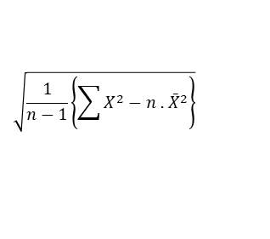

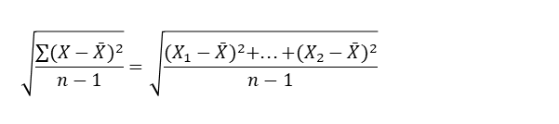


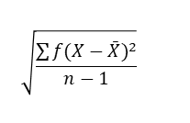
Standard Deviation
It is a statistic that measures the dispersion or variation of a dataset relative to its mean. It is an absolute measure of dispersion that expresses variation in the same units as the original data.
It is defined as the positive square root of the average of the square of the deviations of the measurements from their arithmetic mean.
Notation:
Sample standard deviation = s
Population standard deviation = σ
Sample S.D.
Raw Data
For a sample of n observations x1, x2, …, xn , the standard deviation is given by,
s =
A computationally easier formula is given by,
s =
Note: The divisor n -1 is used instead of n because the sample standard deviation ‘S’ will be much closer to population standard deviation ‘σ’ when we use divisor n – 1.
Ungrouped frequency distribution
For ungrouped frequency distribution we use following formula
Definitional Formula
s =
Computational Formula
s =
Grouped frequency distribution
For grouped frequency distribution the formula are:
Definitional or Direct Formula
s =
Computational Formula
s =
$$\sqrt{\frac{\sum{f(X−\bar{X})^{2}}}{n−1}}$$
$$\sqrt{\frac{1}{n−1}\left\{\sum{f X^{2}−n {\bar{X}}^{2}}\right\}}$$
$$\sqrt{\frac{\sum{(X−\bar{X})^{2}}}{n−1}}=\sqrt{\frac{(X_{1}−\bar{X})^{2}+...+(X_{2}−\bar{X})^{2}}{n−1}}$$
$$\sqrt{\frac{\sum{f(m−\bar{X})^{2}}}{n−1}}$$
$$\sqrt{\frac{1}{n−1}\left\{\sum{X^{2}−n\text{ . }{\bar{X}}^{2}}\right\}}$$
$$\sqrt{\frac{1}{n−1}\left\{\sum{f m^{2}−n {\bar{X}}^{2}}\right\}}$$

Slide 15
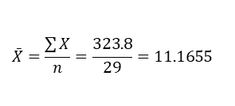

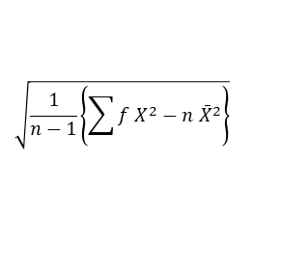
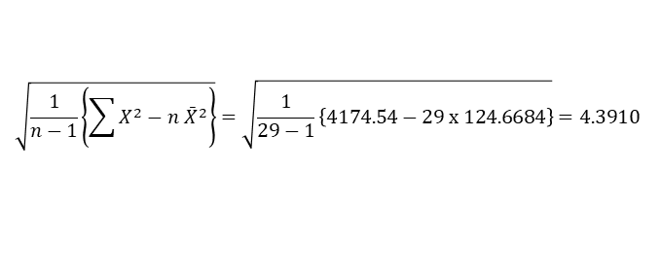
Example 1: The random sample of 29 calls made by office staff of a company during a week is given below:
6.8 2.3 4.8 8.3 15.9 18.7
11.8 5.6 15.9 10.4 15.3 12.3
9.1 10.4 7.2 14.5 11.2 15.3
19.8 7.6 17.7 11.1 9.0 13.2
12.0 3.7 8.0 13.4 12.5
Compute standard deviation of duration of call.
Solution:
Variable (X) = Duration of calls by staff
Sample size (n) = 29
The sample standard deviation is given by,
s =
Here,
Σ X = 6.8 + 2.3 + … + 12.5 = 323.8
Σ X² = 6.8² + 2.3² + … + 12.5² = 4174.54
Now,
Mean mins
S.D.(s) = mins
Example 2: A professor in Statistics class was rated by his 30 students on a scale of 1 to 5 where rating of 5 was considered as excellent and the rating of 1 was considered as poor with increasing scale from poor to excellence. These ratings are recorded individually in the following table.
4 3 1 1 4 5 2 2 4 4
2 3 3 4 3 5 4 4 5 3
3 2 2 3 4 4 5 4 5 1
Construct an ungrouped frequency distribution
Compute standard deviation of rating obtained by Professor
Solution:
Here variable (X) = Rating score given by students
Sample size (n) = 30
The frequency distribution for this data is
The sample S.D. is given by,
s =
$$\sqrt{\frac{1}{n−1}\left\{\sum{X^{2}−n\text{ . }{\bar{X}}^{2}}\right\}}$$
Rate | 1 | 2 | 3 | 4 | 5
Frequency | 3 | 5 | 7 | 10 | 5
$$\bar{X}=\frac{\sum{X}}{n}=\frac{323.8}{29}=\text{11.1655}$$
$$\sqrt{\frac{1}{n−1}\left\{\sum{X^{2}−n {\bar{X}}^{2}}\right\}}=\sqrt{\frac{1}{29−1}\left\{4174.54−29 \text{x}\text{ 124.6684}\right\}}=4.3910$$
$$\sqrt{\frac{1}{n−1}\left\{\sum{f X^{2}−n {\bar{X}}^{2}}\right\}}$$

Slide 16
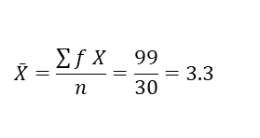
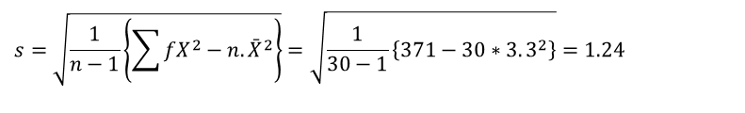
Table
Sample mean is given by
Sample SD is given by
Computing S.D. in grouped frequency distribution
Example 3: The CEO of an IT company wants to study the pattern of absenteeism of employees over a given year. The data from the files of a sample of 50 employees shows the following distribution of number days of these employees were absent.
Compute standard deviation of the distribution
Solution:
The variable (X) = No. of days employee of company remain absent
Frequency (f) = No. of students
First we calculate mean of the distribution and then S.D.
Computation table
No. of days absent | 0 to 2 | 3 to 5 | 6 to 8 | 9 to 11 | 12 to 14 | Total
No. of employees | 15 | 20 | 8 | 5 | 2 | 50
$$\bar{X}=\frac{\sum{f X}}{n}=\frac{99}{30}=3.3$$
$$s=\sqrt{\frac{1}{n−1}\left\{\sum{fX^{2}−n.{\bar{X}}^{2}}\right\}}=\sqrt{\frac{1}{30−1}\left\{371−30∗3.3^{2}\right\}}=1.24$$

Slide 17
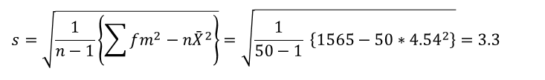
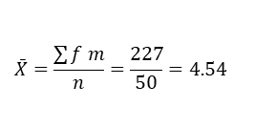
The mean of the distribution is
Now the SD of this distribution is
Hence, the distribution of number of days of absent has mean of 4.54 days and standard deviation of 3.3 days.
Properties of S.D.
The standard deviation (or variance) is better measure of variation in the data because the measures take into account of every observation in the data set.
It is best and powerful measure of variation.
It is least affected by sampling fluctuations.
It gives greater weight to the extreme values and less to those which are near the mean. It is unduly affected by extreme observations.
$$\bar{X}=\frac{\sum{f m}}{n}=\frac{227}{50}=4.54$$
$$s=\sqrt{\frac{1}{n−1}\left\{\sum{fm^{2}−n{\bar{X}}^{2}}\right\}}=\sqrt{\frac{1}{50−1} \left\{1565−50∗4.54^{2}\right\}}=3.3$$

Slide 18

Uses of standard deviation
Spread of the data: The standard deviation is useful in describing departure of individual items in a distribution from the mean i.e. the spread of data. If standard deviation or variance of the data set is large, then data are more dispersed from the mean and in this case the mean becomes less representative.
Comparing consistency of data sets: To check the variability or consistency of two or more samples, we compare their sample standard deviation values. Comparison is possible or sensible when the samples are related or measurements are done on the same variable on different occasions or different group.
Comparing standard scores or Z scores: The sample standard scores tell us how many standard deviations a particular sample observation lies below or above the sample mean. The sample standard score is computed by formula:
It measures the deviation of X from the mean in terms of standard deviations. The standardized variable Z is often used in educational testing, where it is known as a standard score.
4. To know the percentage value in the range: The standard deviation helps tell us how a set of data clusters or distributes around its mean. In other words, S.D. used to determine the number of data value that fall within a specified interval in a distribution.
Empirical rule for normally distributed data:
For normal distribution, the following rule of clustering of data obeys:
(a) The interval includes 68.26 % of observations i.e. about 68 % of the values fall within ± one standard deviation from the mean.
(b) The interval includes 95.44 % of observations.
(c) The interval includes 99.74 % of observations.
$$Z=\frac{Data−Mean}{SD}=\frac{X−\bar{X}}{S}$$

Slide 19
Combined Standard Deviation

Slide 20
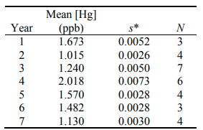
Pooled SD or Combined SD
Example: Suppose you are a Quality Assurance Manager at a leading fish cannery. For seven years, at the same time of the year, your lab has been testing a certain species of fish for mercury. Now you decide to do some long-term statistics for the EPA and need the standard deviation of all the data sets collected.
Calculated overall mean mercury content
Calculated the pooled standard deviation

Slide 21
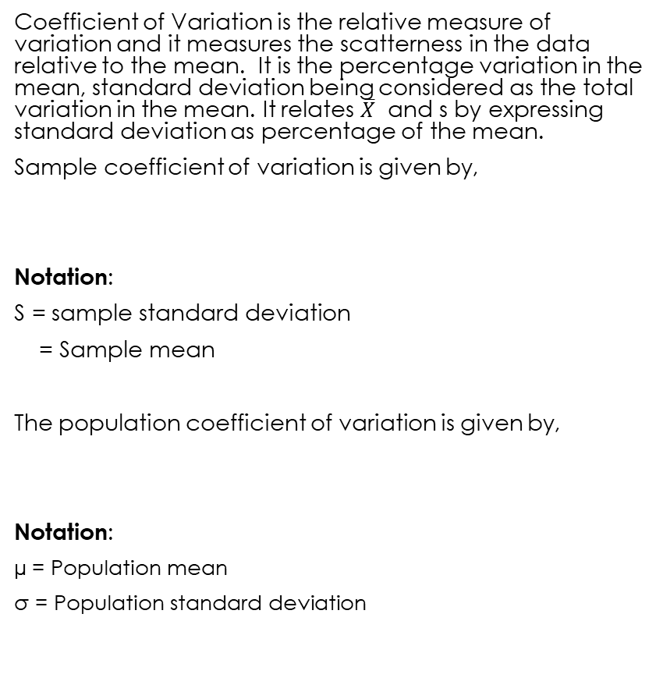


Coefficient of Variation
Coefficient of Variation is the relative measure of variation and it measures the scatterness in the data relative to the mean. It is the percentage variation in the mean, standard deviation being considered as the total variation in the mean. It relates $\overline{X}$ and s by expressing standard deviation as percentage of the mean.
Sample coefficient of variation is given by,
Notation:
S = sample standard deviation
= Sample mean
The population coefficient of variation is given by,
Notation:
µ = Population mean
σ = Population standard deviation
Higher coefficient of variation means high variability or more spread of the data from their mean.
It is particularly useful when comparing the variability of two or more data sets that are expressed in different units of measure. It is also useful when comparing two or more sets of data that are measured in the same units but differ to such an extent that a direct comparison of the respective standard deviations is not very helpful
$$C.V.=\frac{s}{\bar{X}}\text{ ∗ }100\%$$
$$\bar{X}$$
$$C.V.=\frac{σ}{μ}\text{ ∗ }100\%$$

Slide 22
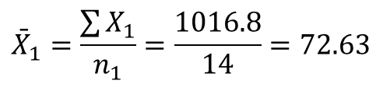
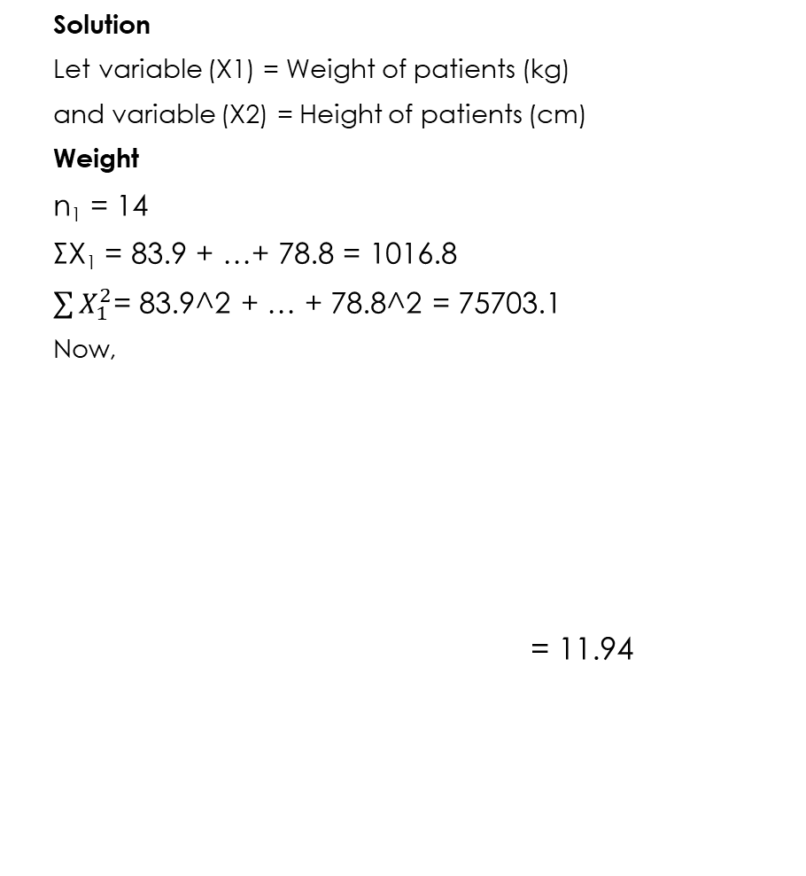


Example
Solution
Let variable (X1) = Weight of patients (kg)
and variable (X2) = Height of patients (cm)
Weight
n₁ = 14
ΣX₁ = 83.9 + …+ 78.8 = 1016.8
$\sum{X_{1}^{2}}$= 83.9^2 + … + 78.8^2 = 75703.1
Now,
= 11.94
The following are the weights (Kg) and heights (cm) of the 14 patients.
Weight
83.9 99.0 63.8 71.3 65.3 79.6
70.3 69.2 56.4 66.2 88.7 59.7
64.6 78.8
Height
185 180 173 168 175 183
184 174 164 169 205 161
177 174
(a)For each variable, compute the mean, standard deviation, and coefficient of variation.
(b)Which set of measurements is more variable, weight or height? On what do you base your answer?
$${\bar{X}}_{1}=\frac{\sum{X_{1}}}{n_{1}}=\frac{1016.8}{14}=72.63$$
$$s_{1}=\sqrt{\frac{1}{n_{1}−1}\left\{\sum{X_{1}^{2}−n_{1} {\overline{X}}_{1}^{2}}\right\}} \\ =\sqrt{\frac{1}{14−1}\left\{75703.1−14∗72.63^{2}\right\}}=11.94$$
$$cv_{1}=\frac{s_{1}}{{\bar{X}}_{1}}∗100\%$$ $=\frac{11.94}{72.63}∗100\%=16.44\%$

Slide 23
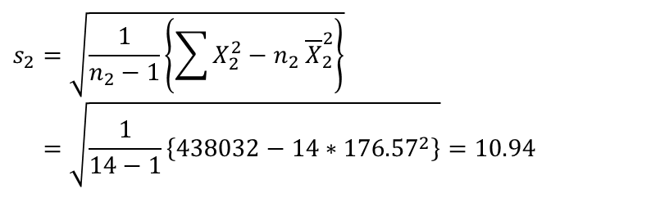
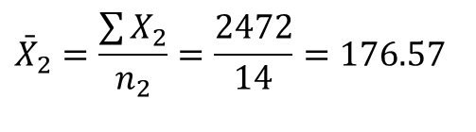
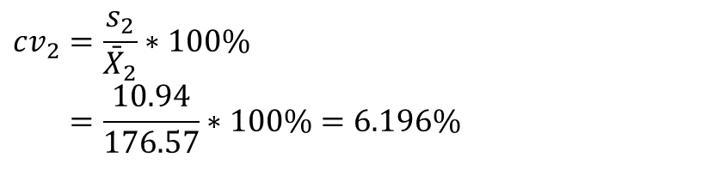
Height
Conclusion: Since coefficient of variation of weight (16.44 %) is higher than that of height (6.196 %), we can conclude that weight is more variable character among a group of patients than the height.
$${\bar{X}}_{2}=\frac{\sum{X_{2}}}{n_{2}}=\frac{2472}{14}=176.57$$
$$s_{2}=\sqrt{\frac{1}{n_{2}−1}\left\{\sum{X_{2}^{2}−n_{2} {\overline{X}}_{2}^{2}}\right\}} \\ =\sqrt{\frac{1}{14−1}\left\{438032−14∗176.57^{2}\right\}}=10.94$$
$$cv_{2}=\frac{s_{2}}{{\bar{X}}_{2}}∗100\% \\ =\frac{10.94}{176.57}∗100\%=6.196\%$$

Slide 24
Example 4:
Two automatic filling machines A and B are used to fill tea in 500 grams bag. A random sample of 100 bag on each machine showed the following results:
Tea Contents (in gm) Machine A Machine B
485 – 490 12 10
490 – 495 18 15
495 – 500 20 24
500 – 505 22 20
505 – 510 24 18
510 – 515 4 13
Total 100 100
Comment on the performance of two machines on the basis of following measures:
(a) Average filling
(b) Variability in filling
(c) Consistency in filling

Slide 25
Solution
Let X₁ = Weight of tea in bags filled by machine A
X₂ = Weight of tea in bags filled by machine B

Slide 26


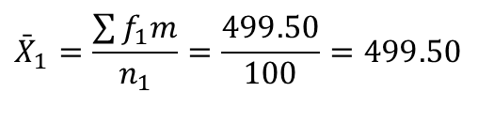


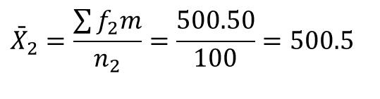
Machine A
Machine B
$${\bar{X}}_{1}=\frac{\sum{f_{1}m}}{n_{1}}=\frac{499.50}{100}=499.50$$
$${\bar{X}}_{2}=\frac{\sum{f_{2}m}}{n_{2}}=\frac{500.50}{100}=500.5$$
$$s_{1}=\sqrt{\frac{1}{n_{1}−1}\left\{\sum{f_{1}m^{2}−n_{1} {\bar{X}}_{1}^{2}}\right\}} \\ =\sqrt{\frac{1}{100−1}\left\{24955125−100∗499.5^{2}\right\}} \\ =7.18$$
$$s_{2}=\sqrt{\frac{1}{n_{2}−1}\left\{\sum{f_{2}m^{2}−n_{2} {\bar{X}}_{2}^{2}}\right\}} \\ =\sqrt{\frac{1}{100−1}\left\{25055725−100∗500.5^{2}\right\}} \\ =7.59$$
$$CV_{1}=\frac{s_{1}}{{\bar{X}}_{1}}∗100\% \\ =\frac{7.18}{499.50}∗100\% \\ =1.44 \%$$
$$CV_{2}=\frac{s_{2}}{{\bar{X}}_{2}}∗100\% \\ =\frac{7.59}{500.5}∗100\% \\ =1.52 \%$$

Slide 27
Conclusion:
Machine B has slightly higher mean (500.5) than machine A (499.5)
Machine A has less variability (7.18) in filling the teabag than machine B (7.59)
Machine A is more consistent (1.44 %) in filling the teabag than machine B (1.52%)
Though there is no significant difference between two machine in terms of average, standard deviation and consistency in filling the teabags with tea, we can say machine A is more closer to the confirmation to the quality than machine B.

Slide 28
Example 3: In a certain test for which the pass marks is 30, the distribution of marks of passing candidates classified by sex (boys and girls) were as given below.
Find the mean and standard deviation of marks obtained by the boys and girls in the test.
Compute coefficient of variation of marks obtained by boys and girls in the test and comment on the consistency of performance for two groups.
Marks | No. of boys | No. of girls
30 – 34 | 5 | 15
35 – 39 | 10 | 25
40 – 44 | 15 | 30
45 – 49 | 30 | 14
50 – 54 | 5 | 5
55 – 59 | 5 | 1
Total | 70 | 90

Slide 29
Example 1:
The scores of individual students in the examination and coursework component of a module are given below:
Compute the coefficient of variation for both component and conclude which component is more variable for a module?
Example 2: 60 students were asked how many books they had read over the past 12 months. The results are listed in the frequency distribution table below.
No. of books 0 1 2 3 4 5 6 7 8
No. of students 1 6 8 10 13 8 5 6 3
Compute mean and standard deviation
Compute coefficient of variation.

Slide 30
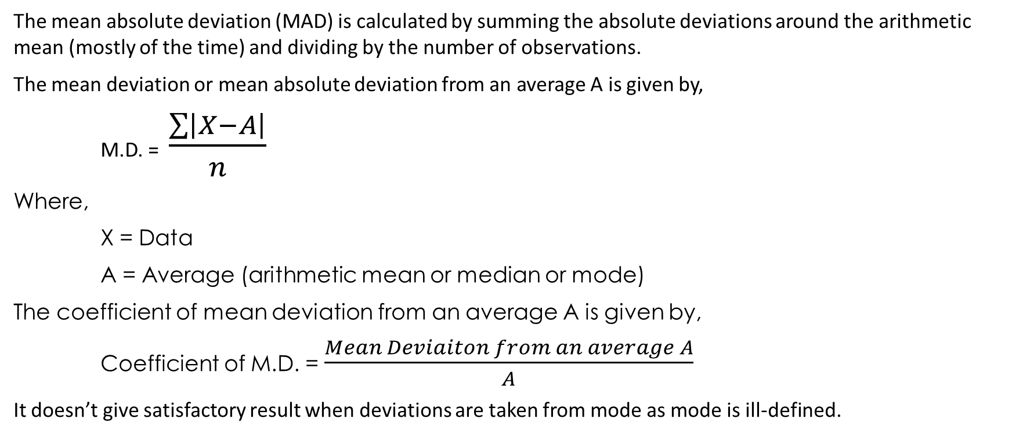
Mean Deviation
The mean absolute deviation (MAD) is calculated by summing the absolute deviations around the arithmetic mean (mostly of the time) and dividing by the number of observations.
The mean deviation or mean absolute deviation from an average A is given by,
M.D. = $\frac{\sum{\left|X−A\right|}}{n}$
Where,
X = Data
A = Average (arithmetic mean or median or mode)
The coefficient of mean deviation from an average A is given by,
Coefficient of M.D. = $\frac{Mean Deviaiton from an average A}{A}$
It doesn’t give satisfactory result when deviations are taken from mode as mode is ill-defined.

